Slide 1
Book-Connect
Onezwa Gibson

Slide 2
Table Of Content
Fixed HTML links
Exported data from the data.js file
Imported data to the scripts.js file
Declared variables
Day and Night theme
Search functionality
Show more button functionality
User expectations

Slide 3
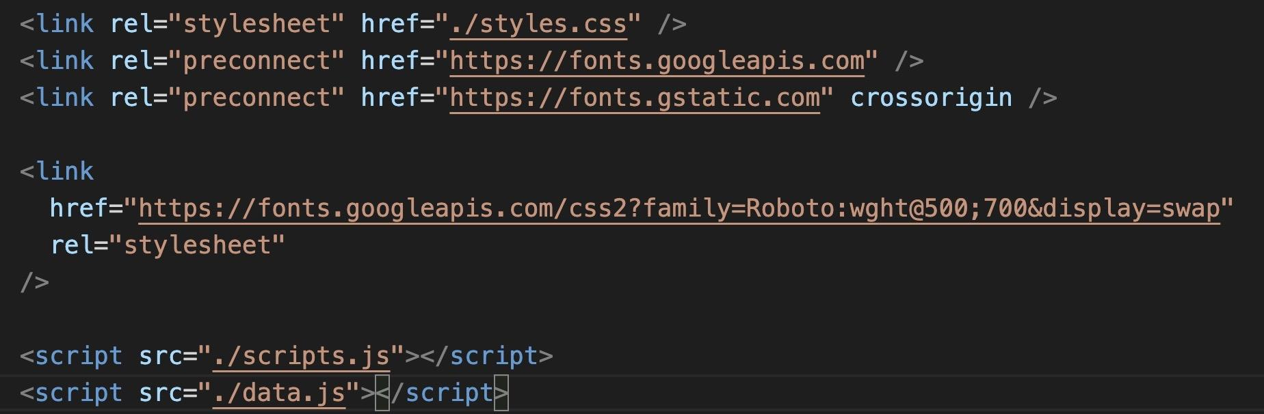
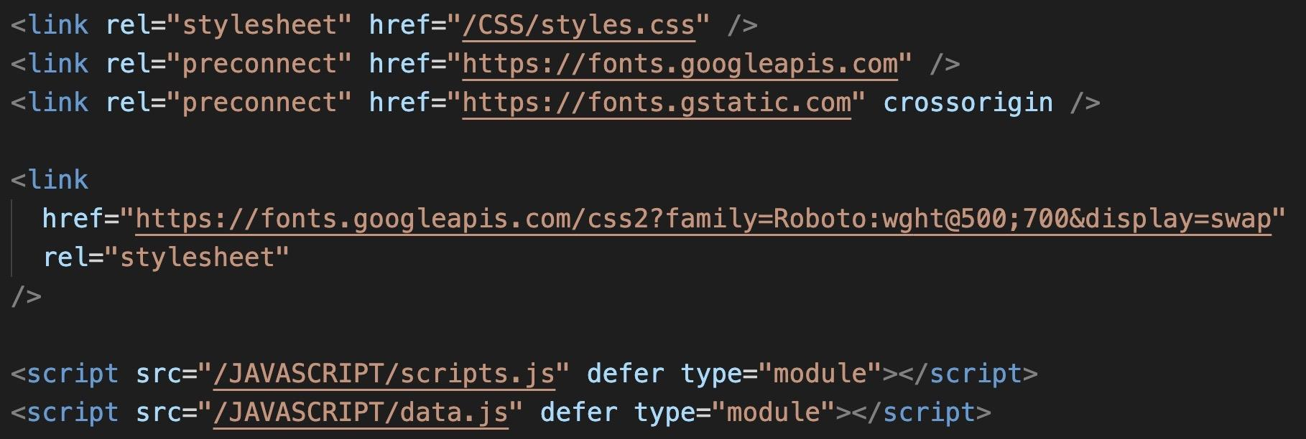
Fixed HTML links
Original Code
Modified Code

Slide 4
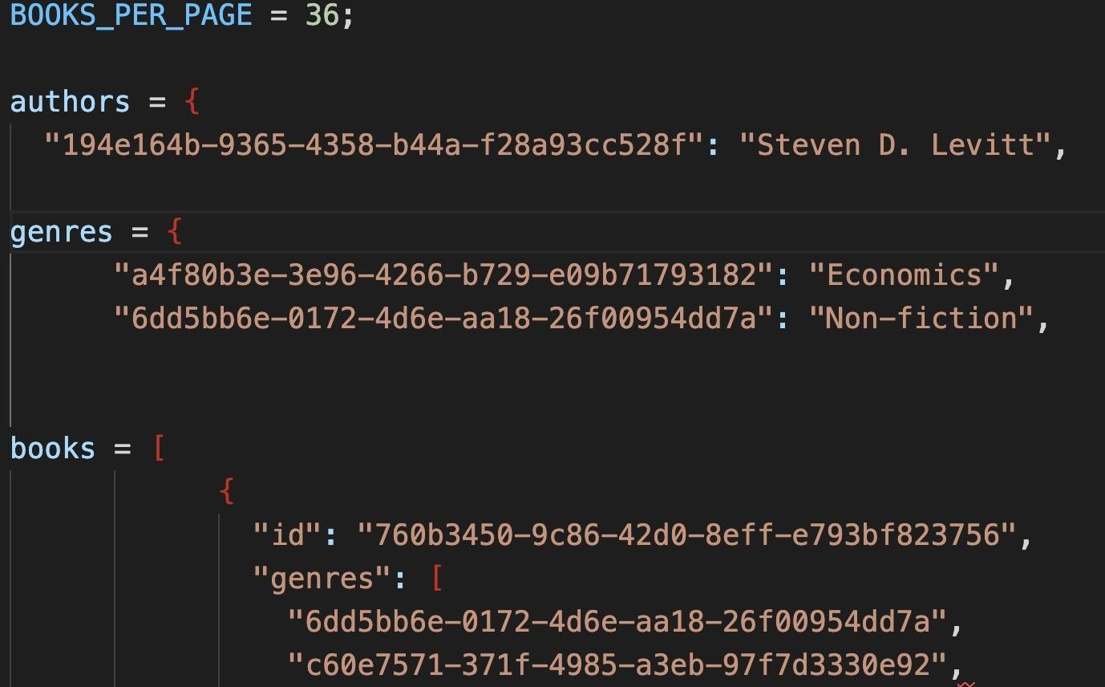
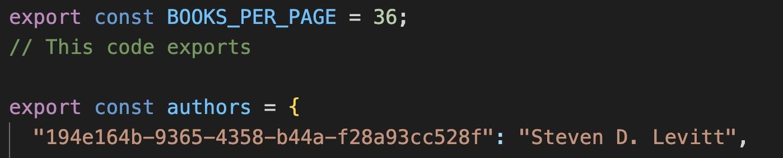
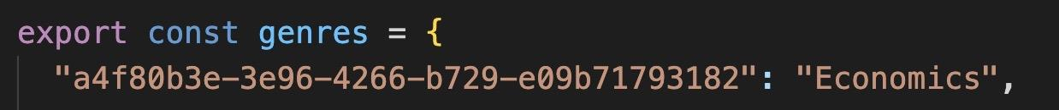
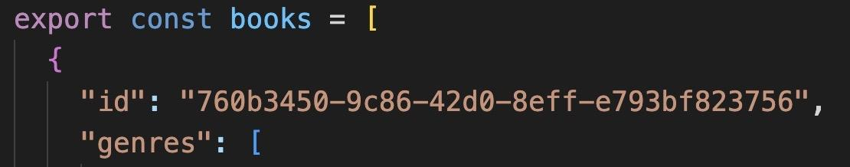
Exported data from the data.js file
Original Code
Modified Code

Slide 5
Imported data to the scripts.js file
Change made
In the scripts.js file I imported the authors object, genres object, books array and the BOOKS_PER_PAGE variable from the data.js file
Files imported

Slide 6
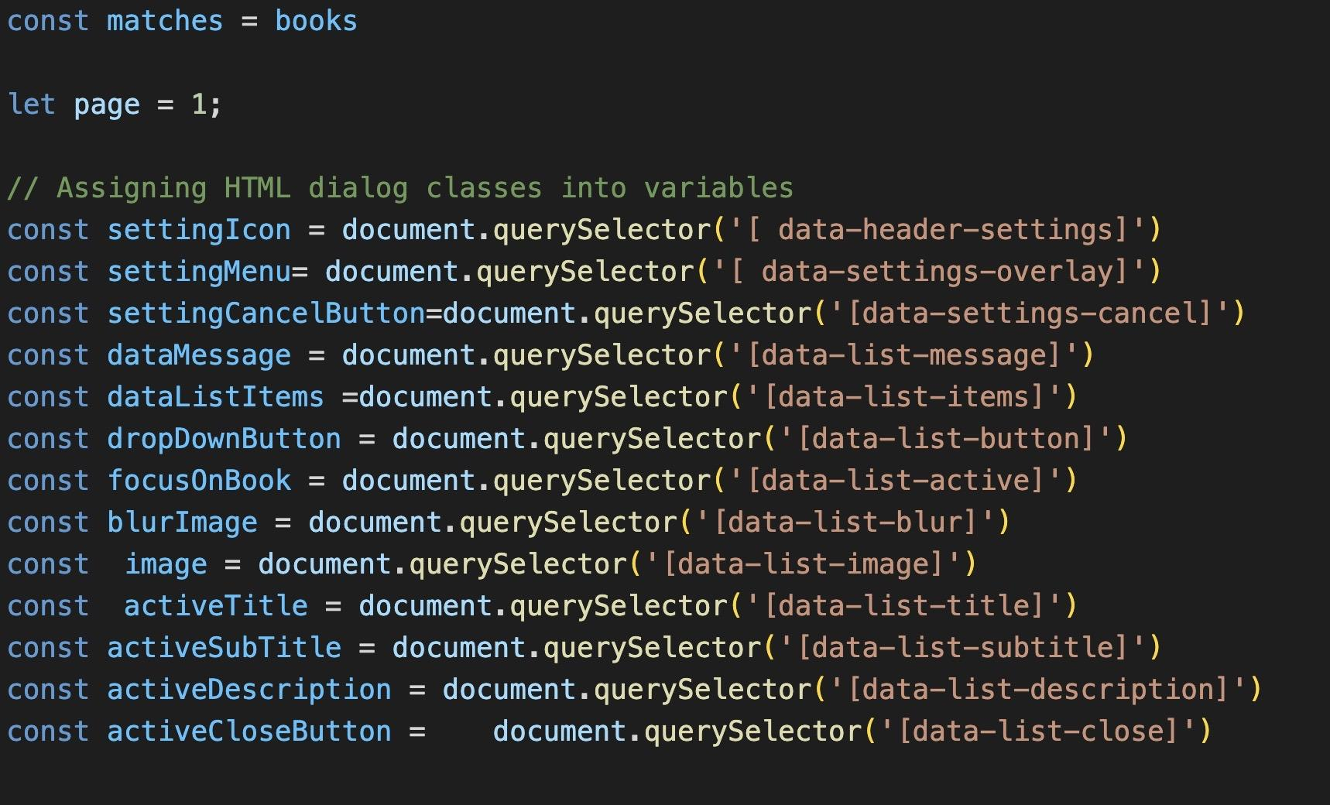
Declared variables
I assigned HTML dialog classes to the variables that I am going to use in my code

Slide 7
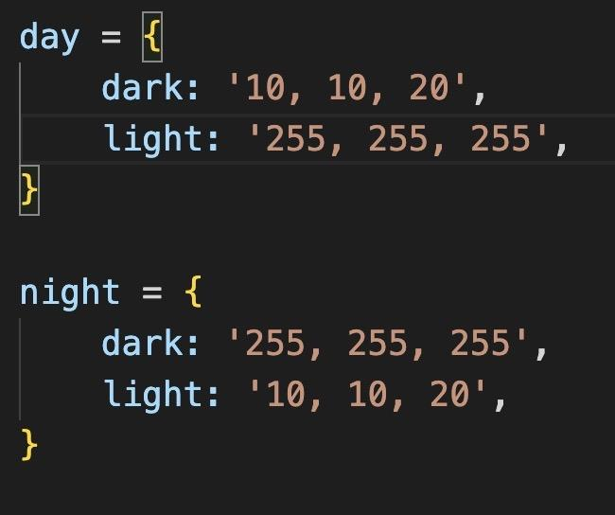
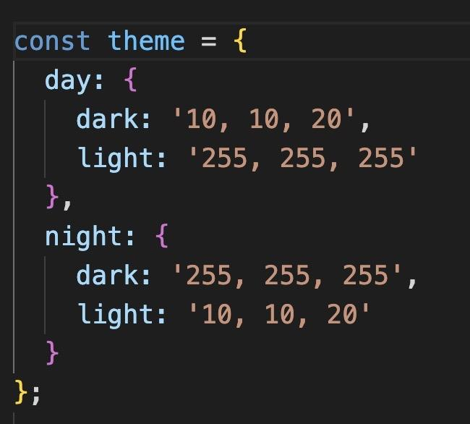
Day and Night theme
Original Code
Modified Code

Slide 8
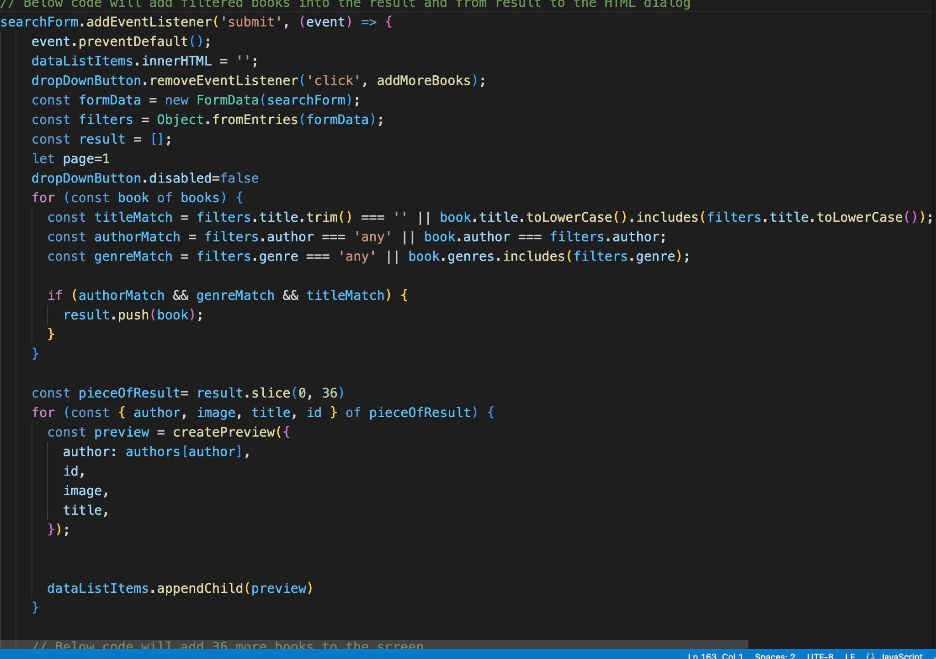
Search functionality
The addEventListener on this code creates a function on the filtering of the books.

Slide 9
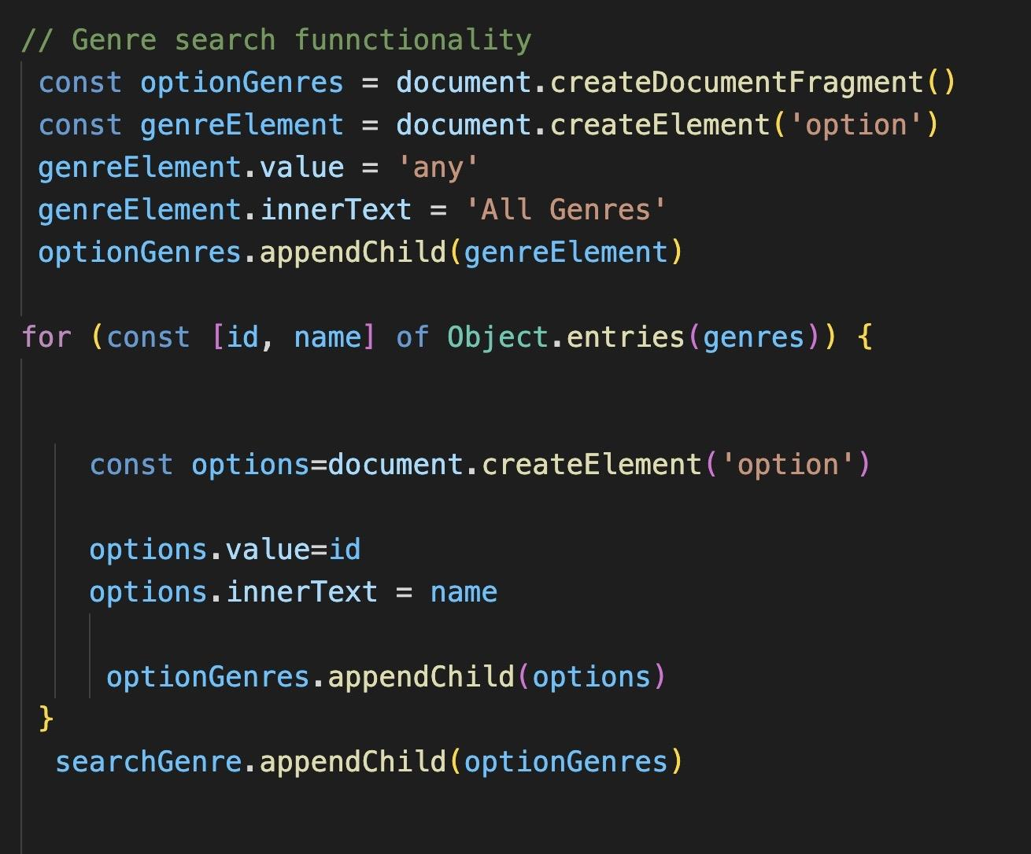
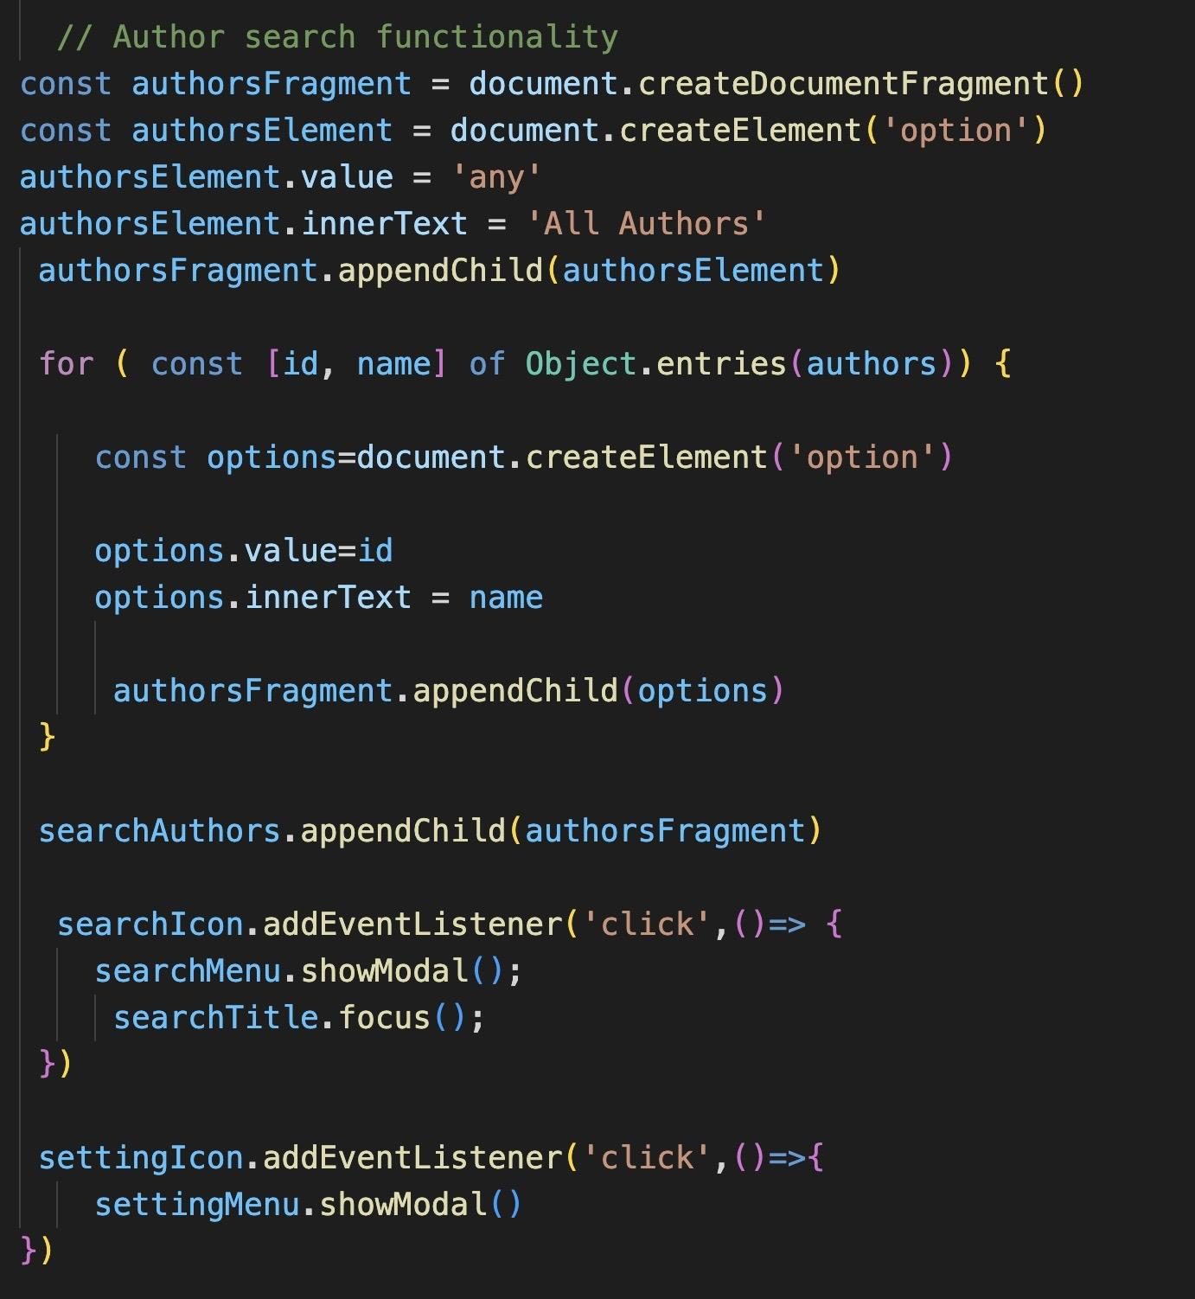
Search functionality
Filter by genre
Filter by author

Slide 10
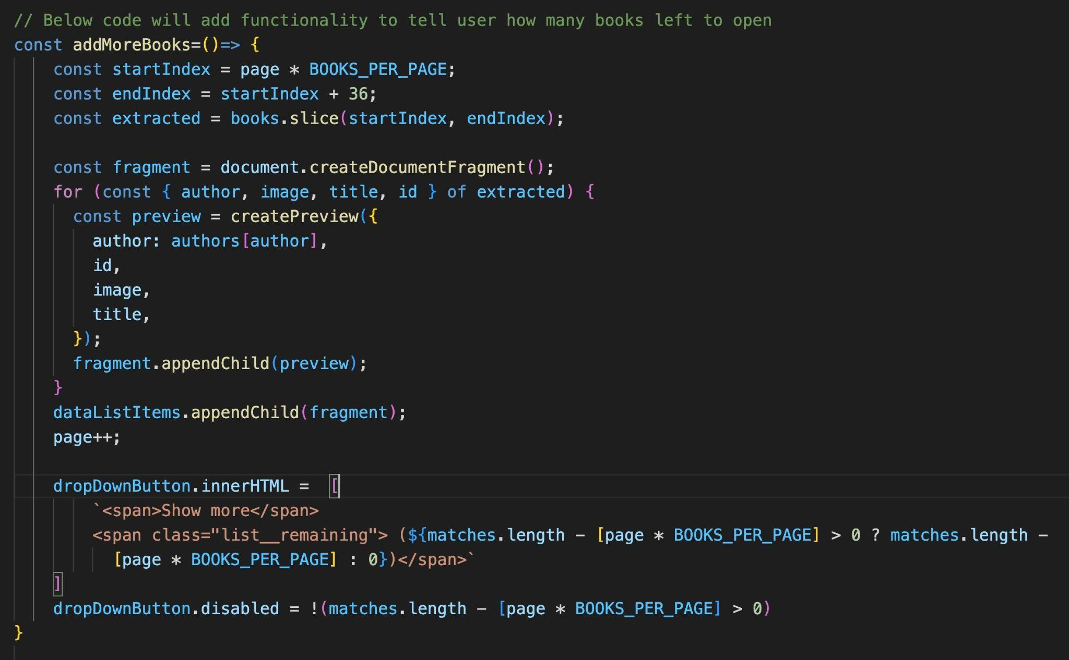
Show more button functionality
This code adds functionality that will add more books in screen when the user clicks on the show more button. It also allows the user to see the remaining books the user can view by showing a number on the button

Slide 11
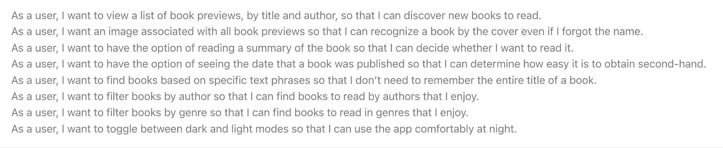
User expectations

Slide 12

Book-connect to be shown on live server >>>
Thank you

